Slide 1
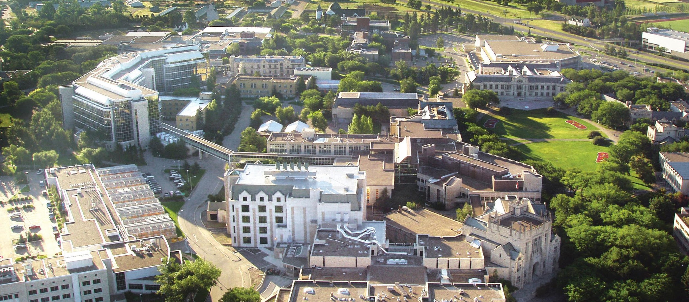


Agent-Based Modeling and Truck Driver Health and Safety: A Novel Approach
www.usask.ca
Notes:
<number>

Slide 2


Michael Kenneth Lemke, Ph.D.
Assistant Professor
Department of Social Sciences
University of Houston-Downtown
Eric Redekopp
MSc. Student
Department of Comp. Sci.
University of Saskatchewan

Slide 3
The Long-Haul Truck Driving Profession: Who They Are, and What They Do
Transport goods across vast distances, often with unpredictable routes based on freight demands
~2,000,000 drivers in the U.S.
300 billion miles driven annually
$800 billion in gross freight revenues annually, accounting for 80% of the nation’s total freight bill
Emerged as essential occupation for implementation and sustainability of COVID-19 policies and strategies
Notes:
Truck drivers are a lynchpin in the American economy, yet are often overlooked for their importance in our day-to-day lives
↓↓↓↓↓↓↓↓↓↓
↓↓↓↓↓↓↓↓↓↓
↓↓↓↓↓↓↓↓↓↓
↓↓↓↓↓↓↓↓↓↓
Emerged: Stay-at-home orders, vaccine delivery, etc.

Slide 4
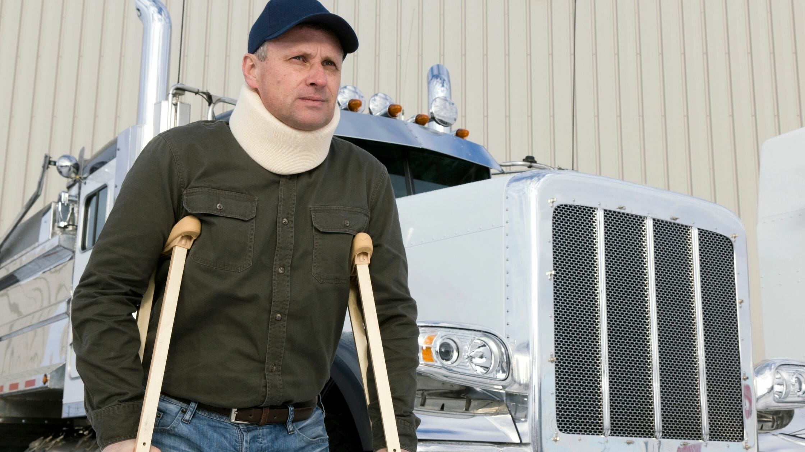
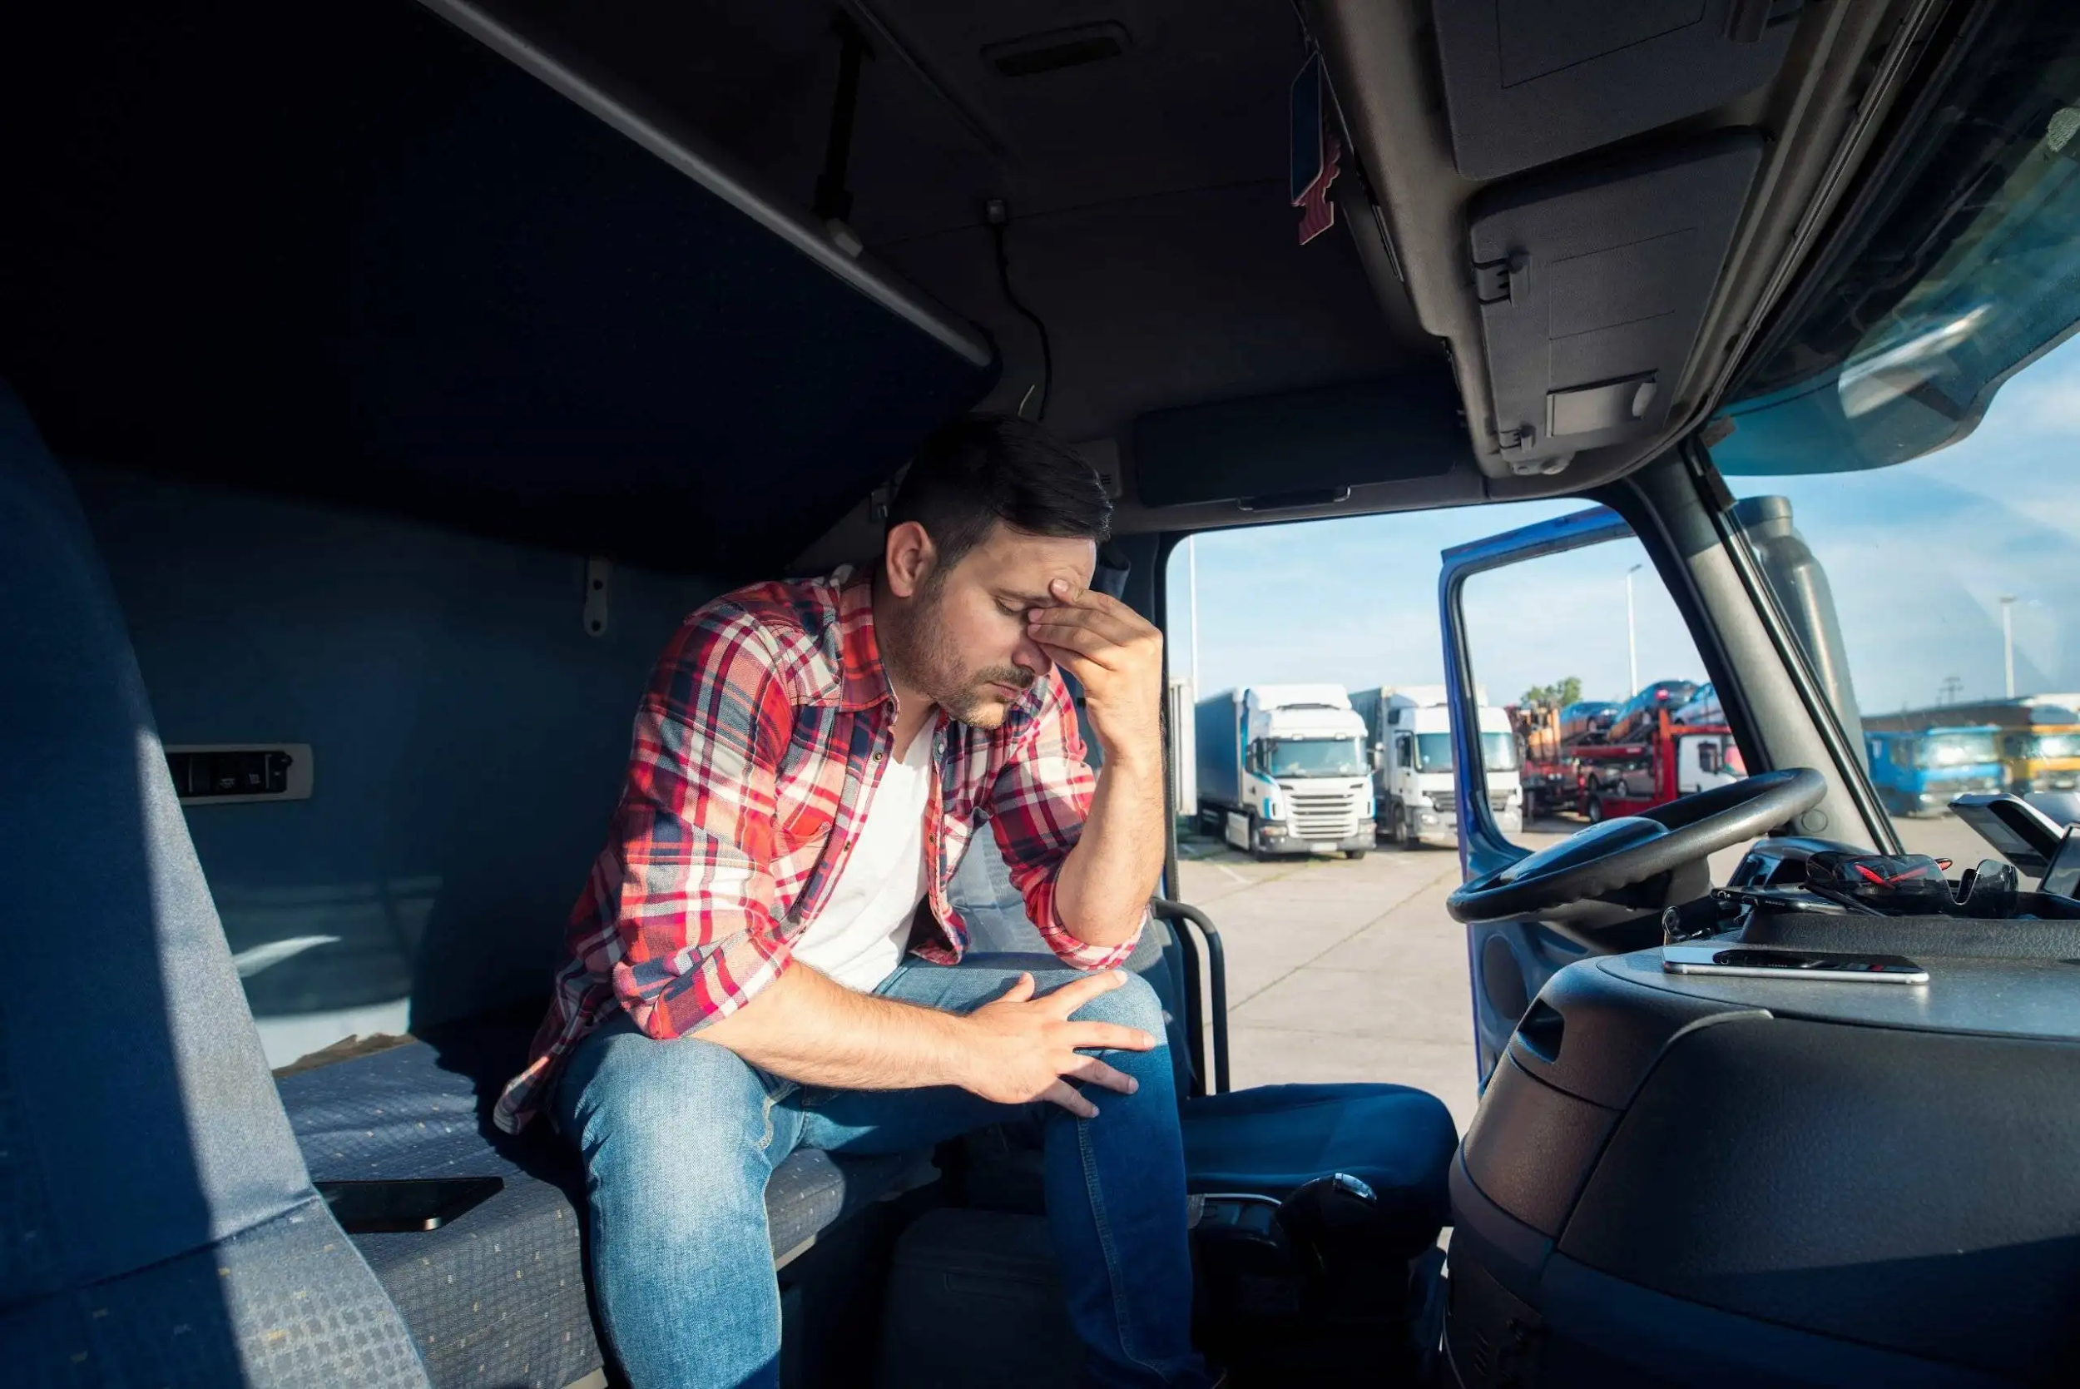
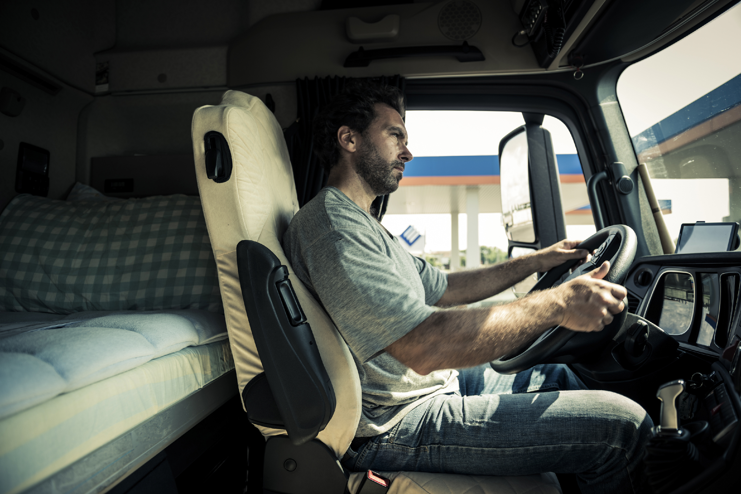
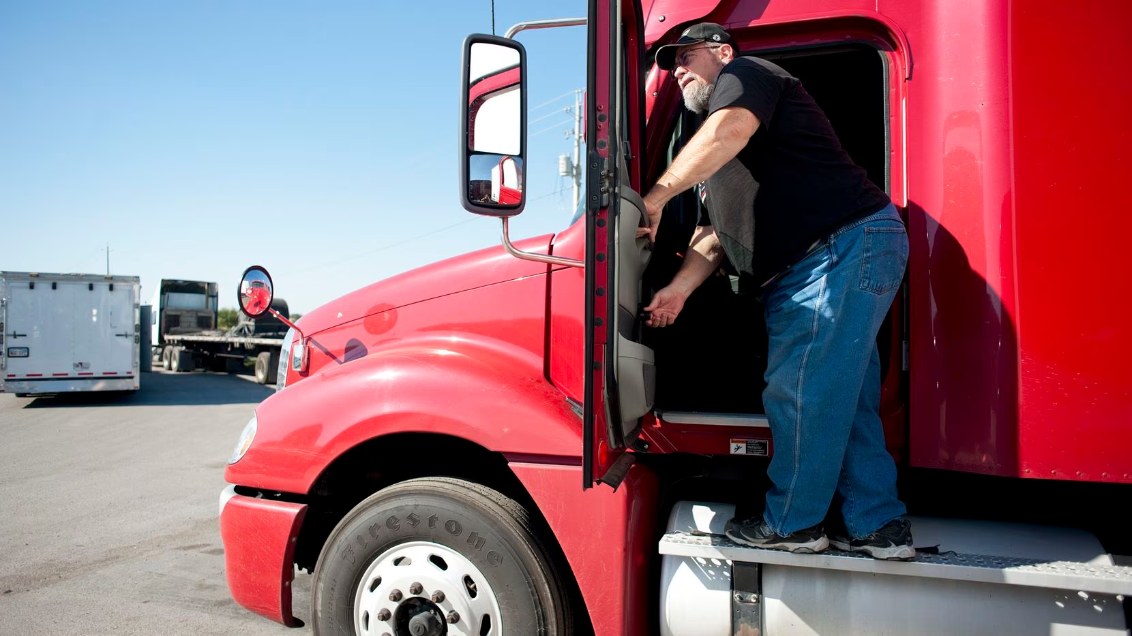
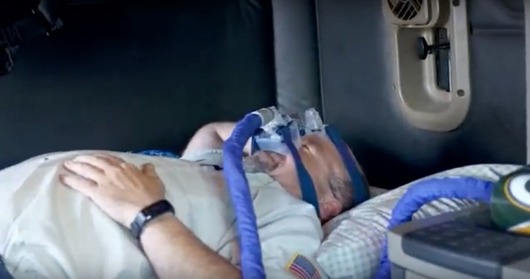
The Long-Haul Truck Driving Profession: Health and Safety Disparities
Notes:
Long-haul truck driving is harmful to physical and mental health
These disparities can be broadly classified into four areas
↓↓↓↓↓↓↓↓↓↓
Cardiometabolic disparities
Cardiovascular disease
Metabolic Syndrome
↓↓↓↓↓↓↓↓↓↓
Acute and chronic injury disparities
Roadway crashes
Musculoskeletal injuries
↓↓↓↓↓↓↓↓↓↓
Mental health disparities
Psychiatric/mental health disorders
Work-induced or –exacerbated behavioral risks
↓↓↓↓↓↓↓↓↓↓
Other disparities
Sleep disorders
Chemical exposures (e.g., worksite pollution)

Slide 5
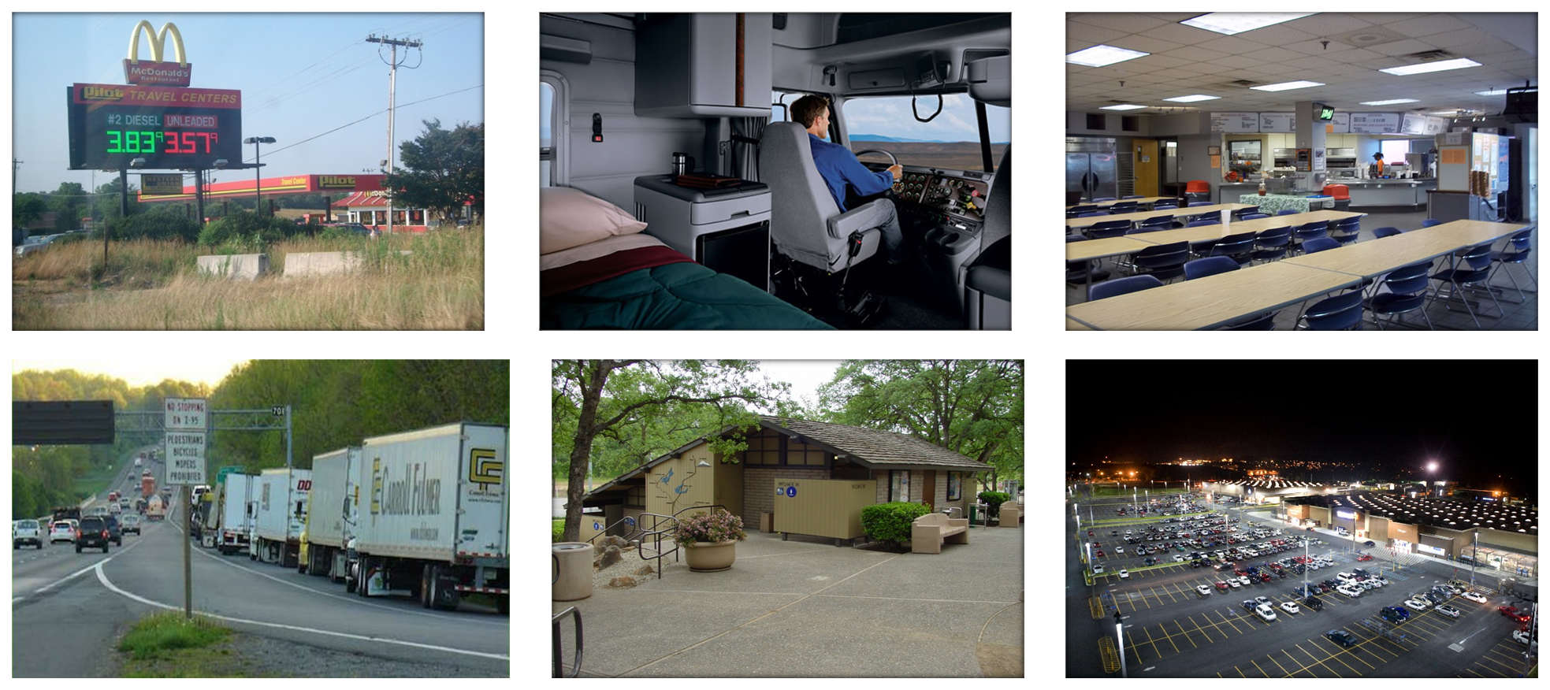
Truck Driver Worksites
Notes:
Beyond LHTD, environmental characteristics – especially worksites – are uniquely important to LHTD health and safety outcomes
LHTD encounter a diverse array of worksites during their work, including…
Truck stops
Their truck cabs
Company facilities
Rest and parking areas
And Wal-Marts
To name a few

Slide 6
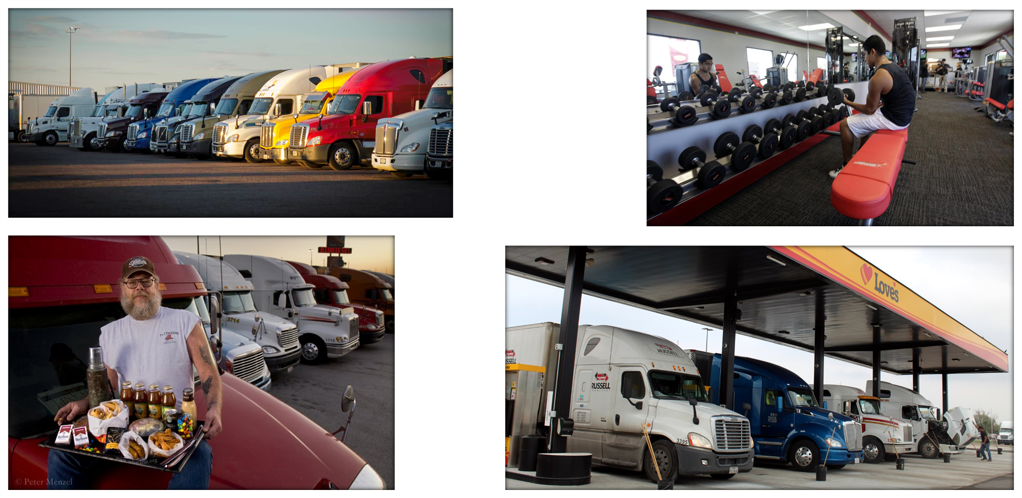
Worksites Provide Basic Needs
Notes:
Understanding these worksites is crucial, because truck drivers are reliant on the attributes of these locales to meet their basic needs while on the road, including sleep, physical activity, nutrition, and fueling

Slide 7
Why ABM for Trucker Health and Safety?
Truck driver health and safety outcomes are dynamically complex
ABM is uniquely adept for capturing key causal mechanisms – or generative mechanisms – that give rise to truck driver health and safety outcomes
These mechanisms are currently hypothesized as four ‘archetypes’ that constitute the ‘architecture’ of our baseline model
Notes:
Because they are dynamically complex, policy resistance is an important threat to any prevention endeavors
Uniquely adept: As we will discuss, these mechanisms embody several complex systems concepts that correspond with the strengths of ABM
By “give rise”, we are referring to emergence

Slide 8
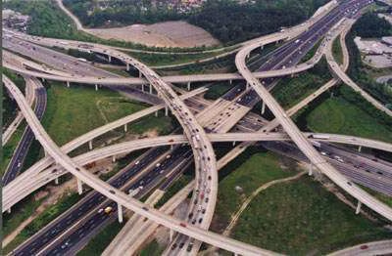

Archetype 1: Stochastic Mobility
Notes:
Stochastic mobility – drivers have highly unpredictable routes that are contingent on factors that are difficult to forecast beyond a short time period
Complex systems theoretical concepts: Temporal (dynamic) effects (e.g., delays; path dependence)
Implications for health/safety: Effects of driver routing/dispatching on exposures – for many routes, there is usually a limited number of roadways that can feasibly be taken, with corresponding constraints on what resources can be accessed along these routes

Slide 9
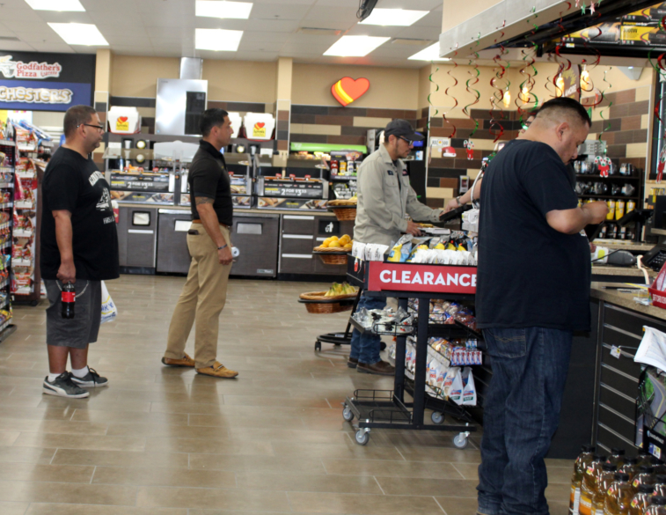
Archetype 2: Vulnerable Network Characteristics
Notes:
Vulnerable network characteristics – driver networks are noted for having properties that may amplify risks of spread (e.g., infectious disease; information) across networks
Complex systems theoretical concepts: Feedbacks/reciprocal causality through agent-agent and agent-environment interactions that generate nonlinearities
Implications for health/safety: Agent-agent interactions in the acquisition/transmission of infectious disease, and potential of latent tipping points in spread of disease along trucker networks

Slide 10
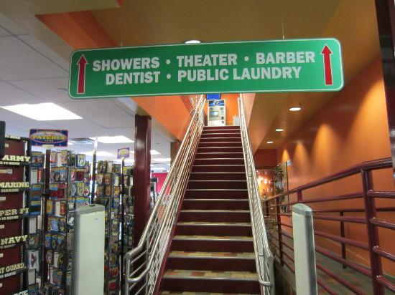
Archetype 3: Dependence on Constrained Resource Environments
Notes:
Dependence on constrained resource environments – drivers are uniquely dependent on roadside built environments for basic needs, yet have limited volition in the selection of resources due to their large vehicles that limit the array of resources that can be accessed
Complex systems theoretical concepts: Heterogeneity (among individuals and explicit spatial environments)
Implications for health/safety: Differences among truck stop entities (e.g., chain vs. independent locations) in characteristics of retail food environments

Slide 11
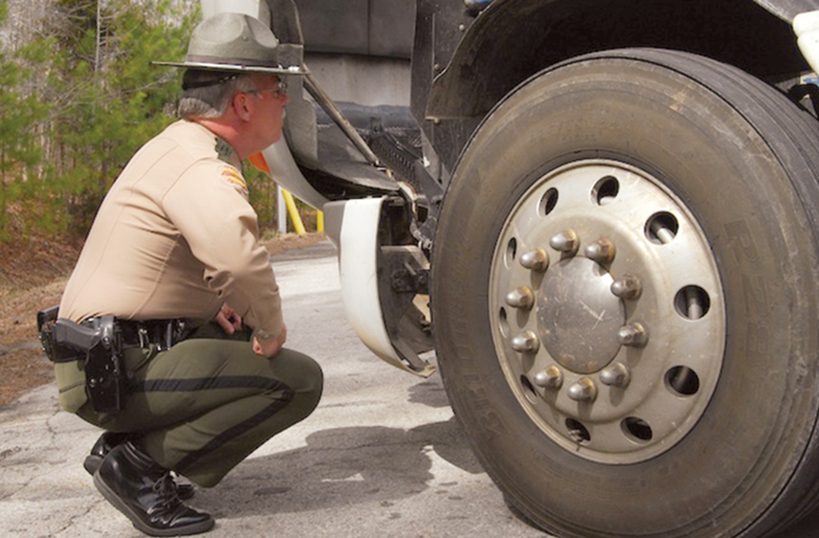
Archetype 4: Restrictive Policy Environment
Notes:
Restrictive policy environment – driver behavior ‘rules’ are governed by a dizzying array of federal, state, and corporate policies pertaining to work hours, rest hours, vehicle inspections, medical certification, operating procedures, etc.
Complex systems theoretical concepts: Disaggregated (individual-level) characteristics (e.g., effects of local environment/localized perception; diverse actors) and behaviors (e.g., siloed perception, decision-making, learning, and adaptation based on context)
Implications for health/safety: Varied adherence to trucking industry policies (e.g., compliance with hours-of-service regulations)

Slide 12
The Truck Parking Problem
As a case study, the first iteration of the truck driver model will focus on a major issue – the lack of safe and available truck parking
Lack of safety and available truck parking has numerous implications for truck driver health and safety…and the safety of the motoring public as well!
Current solutions appear to be low-leverage
Can ABM identify novel, high-leverage solutions?
Notes:
We chose this for a case study because it is somewhat less complex – especially compared to problems such as nutrition (where driver behavior and preferences are more salient)
Long-haul truck drivers do not go home every night – they sleep in their trucks
Lack of safe and available truck parking has implications for roadway safety, sleep health, mental health and physical safety
Low-leverage – spatiotemporally limited in scope, behavior-based, and not up to the task given the dynamic complexity of the problem – thus, rife for policy resistance

Slide 13
Model Implementation
Drivers interact within a realistic GIS environment
Drive between random cities
Use decision-making process to find truck stops
Drivers interact at truck stops
Truck stops may or may not have enough space for drivers to park
Key components
Trucker behaviour
Trucker routing
GIS data

Slide 14
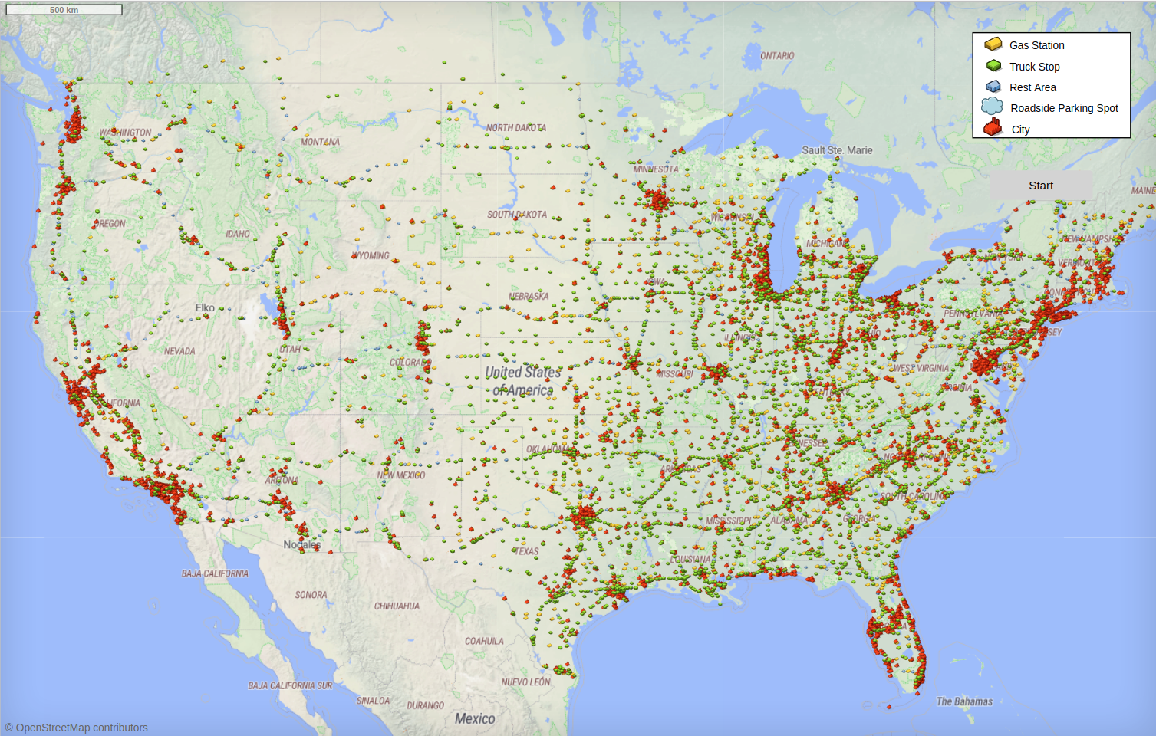

Slide 15
Trucker Behaviour
Assign a destination
Shipper, receiver, or home
Each time we start driving:
Select where to stop
Direct to destination? Stop at a truck stop? Which stop?
Select what to do at the stop
Sleep for the night? Refuel and keep driving?
Networks
Truckers at the same location temporarily enter a shared network

Slide 16
Trucker Routing
How to handle the large number of cities?
Gravity Model
Borrowed from gravitational simulations
Cities are “planets”, with population size as “mass”
Select random cities weighted by population and distance
“Gravitational force”
Quadtree data structure
(Slightly customized for our use case)
Allows efficient implementation of the above
Automatically group “galaxies” together as a unit

Slide 17
GIS Data
We want our model to have a very rich dataset
Realistic conditions
Compelling to outside stakeholders
Easy to compare against real-world data
Model runs in GIS environment representing the entire contiguous USA
Trucks should drive along realistic routes and stop in realistic places
What data do we need?
Cities
Highways
Locations where truckers stop

Slide 18
Cities Data
USA census data is readily available with populations for major cities
Accessed through the internet

Slide 19
Highways Data
OpenStreetMap has free and open-source maps of public roads across the world
Integrated with AnyLogic
By default, will search for map data online
Download the data for improved performance
Agents navigate along roads with no special programming necessary

Slide 20
Truck Stop Data
This part was more tricky...
Types of truck stop:
Truck Stop
Full amenities including food, fuel, and overnight parking spaces
Gas Station
Food and fuel available, but no overnight parking spaces
Rest Area
Overnight parking available, but no food or fuel
Usually government-operated, such as a state “welcome centre”

Slide 21
Truck Stop Data (2)
Truck Stops
Allstays PDF dataset
Used Python script to extract data from PDF file
Gas Station
Allstays again
Only stops with <5 parking spaces
Rest Area
Interstaterestareas.com custom Google Maps file
Downloaded as .kml and extracted location data
No parking data – determined randomly
Working on acquiring even more data

Slide 22

Communication Across Domains
So far, mostly worked as a team of two
Michael – health science and trucking
Eric – scientific computing
Health and computing are different languages
How do we communicate?

Slide 23
Boundary Object
Boundary objects are objects which are both plastic enough to adapt to local needs and constraints of the several parties employing them, yet robust enough to maintain a common identity across sites.
Star and Griesemer, 1989
Boundary objects allow communication across domains
They provide a common language

Slide 24
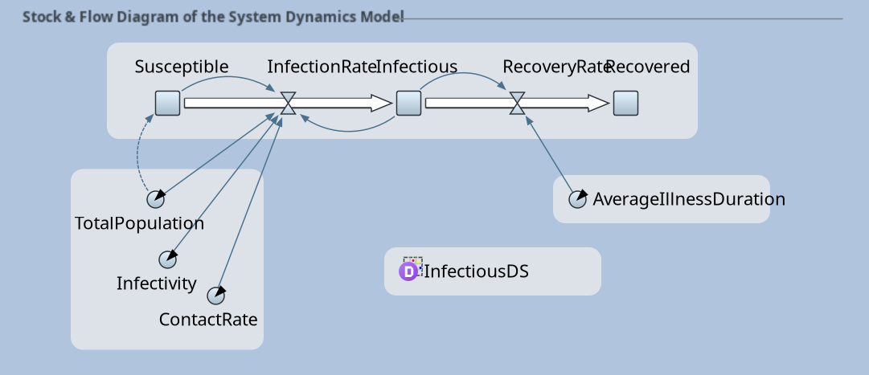
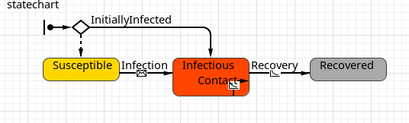
Diagrams
Diagrams are frequently used as boundary objects in modelling
Stock and flow diagrams in SD models
State charts in ABM models
etc.
Many of these are built in to AnyLogic already

Slide 25
Critical Components
Communicate critical processes that drive model behaviour through boundary objects
Critical processes in trucker model:
How do truckers decide where to stop?
How are truckers assigned their destinations?
These are mostly decision processes.

Slide 26

Flow Charts
Flow charts are useful boundary objects for representing a decision process
Trucker’s perspective:
Does the flow chart match my personal experience?
Programmer’s perspective:
Is the flow chart complete enough to implement in code?

Slide 27
Building Flow Charts
Build in collaborative sessions
Build alongside the code
Code will reveal special cases
Our favourite tool is draw.io
Integrated with Google Drive
Simultaneous viewing / editing
app.diagrams.net

Slide 28
Flow Chart Example
...

Slide 29
Model Example
...

Slide 30
Next Steps
Current ABM is conceptual and will be used as a ‘case study’ for architectural approach
This is the first step in what we hope will be a broader modeling enterprise:
Primary data collection for baseline model (parameterization, calibration, validation, etc.)
Apply baseline model to other topics/research questions (e.g., nutrition; physical activity; infectious disease)
Notes:
Current: We are especially interested in finding out whether these four archetypes lead to emergent behavior that parallels reality!
First step: Instead of one-and-done models, we hope that this “architectural” approach can create in reproducible and more rapidly responsive research (e.g., to respond to novel threats to health/safety)

